Slide 1
Highlights of findings on democracy in West Africa
4 February 2025
WADEMOS Annual Conference
Anyway Chingwete
Deputy Director of Surveys
Afrobarometer

Slide 2
At a glance
Support for democracy
On average across 15 West African countries, support for democracy remains robust.
Growing majorities call for government accountability and the rule of law, and support for other democratic norms has held steady over the past decade.
But across 13 West African countries surveyed consistently over the past decade, support for democracy has declined and opposition to military rule has weakened.
West Africans are less likely to reject military rule (58%) than the rest of the African citizens (66%).
More than half of West Africans (56% across 15 countries) are willing to accept a military takeover if elected leaders “abuse power for their own ends.”
Supply of democracy
Fewer than half (48%) of West Africans think their countries are mostly or completely democratic, and only 39% say they are satisfied with the way democracy works in their countries.

Slide 3
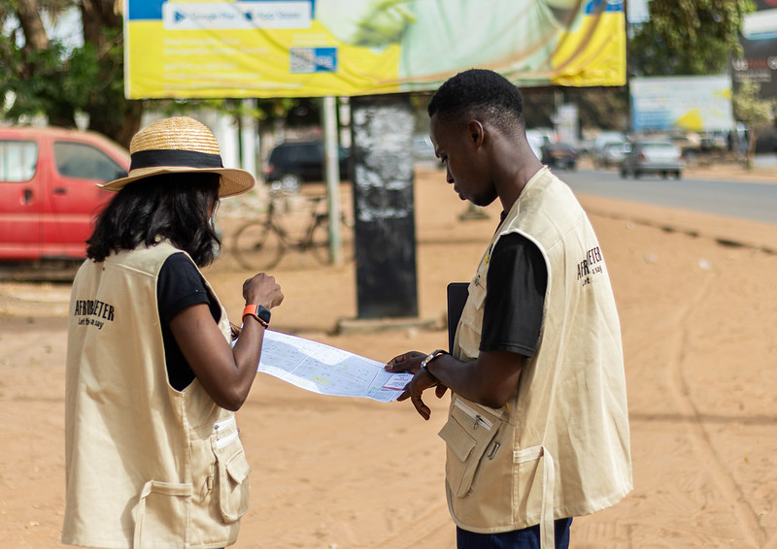
What is Afrobarometer
Pan-African, non-partisan survey research network that provides reliable data on African experiences and evaluations of democracy, governance, and quality of life.
Goal: To give African publics a voice in policy and decision making.
Nine survey rounds in up to 42 countries have been completed since 1999.
Round 10 surveys were launched in January 2024 and are expected to run to mid 2025.

Slide 4
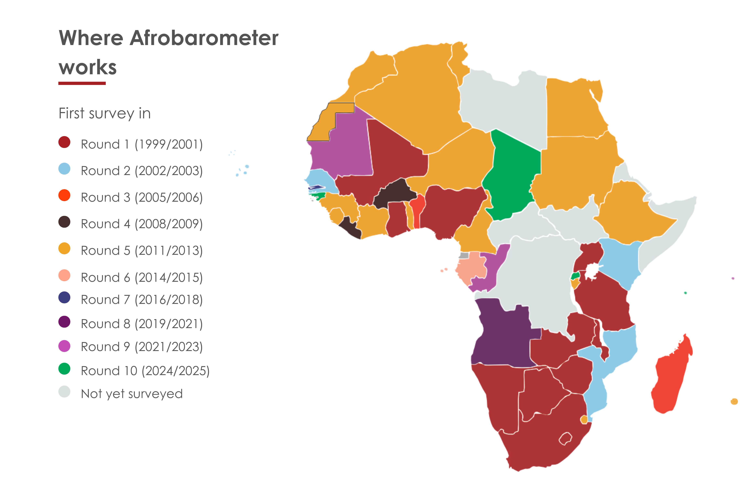

Slide 5
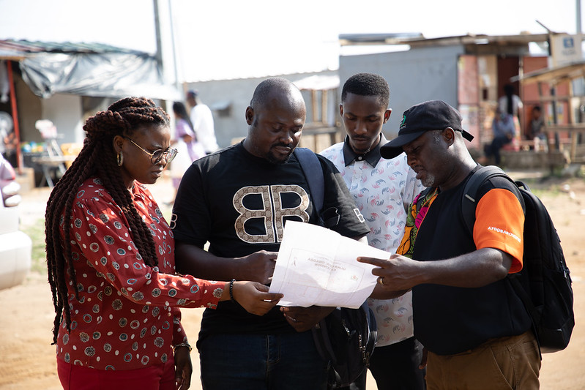
Methodology
Nationally representative sample of adult citizens (aged 18+)
Face-to-face interviews in the language of the respondent’s choice
Standard questionnaire allows comparisons across countries and over time.
Sample sizes of 1,200 or 2,400 yield country-level results with margins of sampling error of +/-2 or 3 percentage points.

Slide 6
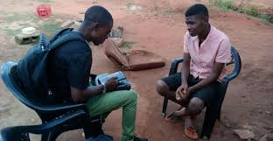
Democracy in Africa: Trends in popular support and satisfaction

Slide 7
Support for democracy and rejection of authoritarian rule | West Africa vs Africa | 2021/2023
Respondents were asked: Which of these three statements is closest to your own opinion? Statement 1: Democracy is preferable to any other kind of government. Statement 2: In some circumstances, a non-democratic government can be preferable. Statement 3: For someone like me, it doesn’t matter what kind of government we have.
(% who say democracy is preferable)
There are many ways to govern a country. Would you disapprove or approve of the following alternatives:
Only one political party is allowed to stand for election and hold office.
The army comes in to govern the country.
Elections and Parliament are abolished so that the president can decide everything.
(% who “disapprove” or “strongly disapprove”)

Slide 8
Prefer democracy to any other alternative | 15 West African countries | 2021/2023
Respondents were asked: Which of these three statements is closest to your own opinion? Statement 1: Democracy is preferable to any other kind of government. Statement 2: In some circumstances, a non-democratic government can be preferable. Statement 3: For someone like me, it doesn’t matter what kind of government we have.
(% who say democracy is preferable)

Slide 9
Changes in preference for democracy | 13 West African countries | 2014-2023
Figure shows changes (in percentage points) of the proportion between 2014/2015 and 2021/2023 who say democracy “is preferable to any other kind of government .

Slide 10
Reject one-party rule | 15 West African countries | 2021/2023
Respondents were asked: There are many ways to govern a country. Would you disapprove or approve of the following alternatives:
Only one political party is allowed to stand for election and hold office.
(% who “disapprove” or “strongly disapprove”)

Slide 11
Reject one-man rule | 15 West African countries | 2021/2023
Respondents were asked: There are many ways to govern a country. Would you disapprove or approve of the following alternatives:
Elections and Parliament are abolished so that the president can decide everything.
(% who “disapprove” or “strongly disapprove”)

Slide 12
Reject military rule | 15 West African countries | 2021/2023
Respondents were asked: There are many ways to govern a country. Would you disapprove or approve of the following alternatives:.
The army comes in to govern the country.
(% who “disapprove” or “strongly disapprove”)

Slide 13
Changes in rejection of military rule (percentage points) | 13 West African countries | 2014-2023
Figure shows changes (in percentage points) of the proportion between 2011/2013 and 2021/2023 who “disapprove” or “strongly disapprove” of the idea that “the army comes in to govern the country.”

Slide 14
Trends in support for democracy and rejection of authoritarian rule | 13 African countries | 2014-2023
Notes:
Changes between 2011-2023 Rejection of one-man rule: -3 Reject one-party rule: 0 Reject military rule: -11 Prefer democracy: -7

Slide 15
Support for multiparty competition | 15 West African countries | 2021/2023
Respondents were asked:
Which of the following statements is
closest to your view?
Statement 1: Political parties create
division and confusion; it is therefore
unnecessary to have many political
parties in [country].
Statement 2: Many political parties
are needed to make sure that [country] have real choices in
who governs them. (% who “agree”
or “strongly agree” with Statement 2)

Slide 16
Support for accountable governance | 15 West African countries | 2021/2023
Respondents were asked: Which of
the following statements is closest to
your view?
Statement 1: It is more important to
have a government that can get
things done, even if we have no
influence over what it does.
Statement 2: It is more important for
citizens to be able to hold the
government accountable, even if
that means it makes decisions more
slowly.(% who “agree” or “strongly
agree” with statement 2)

Slide 17
Support for elections | 15 West African countries | 2021/2023
Respondents were asked: Which
of the following statements is
closest to your view?
Statement 1: We should choose
our leaders in this country through
regular, open, and honest
elections.
Statement 2: Since elections
sometimes produce bad results,
we should adopt other methods
For choosing this country’s
leaders. (% who “agree” or
“strongly agree” that leaders
should be chosen through
elections)

Slide 18
Support for presidential term limit | 15 West African countries | 2021/2023
Respondents were asked:
Which of these statements is
closest to your own opinion?
Statement 1: The Constitution
should limit the president to
serving a maximum of two
terms in office.
Statement 2: There should be
no constitutional limit on how
long the president can serve.
(% who “agree” or “strongly
agree” with Statement 1)

Slide 19
The military can intervene in politics if elected leaders abuse power | 15 West African countries | 2021/2023
Respondents were asked: Which of the following statements is closest to your view?
Statement 1: [Country’]s armed forces should never intervene in the country’s political process.
Statement 2: It is legitimate for the armed forces to take control of government when elected leaders abuse power for their own ends.
(% who “agree” or “strongly agree” with Statement 2)

Slide 20
Satisfaction with democracy | 15 West African countries | 2021/2023
Respondents were asked: Overall, how satisfied are you with the way democracy works in [country]?
(% who say “fairly satisfied” or “very satisfied”)

Slide 21
Changes in satisfaction with democracy (percentage points) | 13 West African countries | 2014-2023
Figure shows changes (in percentage points) of the proportion between 2014/2015 and 2021/2023 who say they are “fairly satisfied” or “very satisfied” with the way democracy is working in their country.

Slide 22
Perceive country to be a democracy | 15 West African countries | 2021/2023
Respondents were asked: In your opinion, how much of a democracy is [country] today?
(% who say “a full democracy” or “a democracy with minor problems)

Slide 23
Changes in perception that country is a democracy (percentage points) | 13 West African countries | 2014-2023
Respondents were asked: In your opinion, how much of a democracy is [country] today?
(% who say “a full democracy” or “a democracy with minor problems)

Slide 24
Views on democracy and governance | by age group | 15 countries |2021/2023

Slide 25
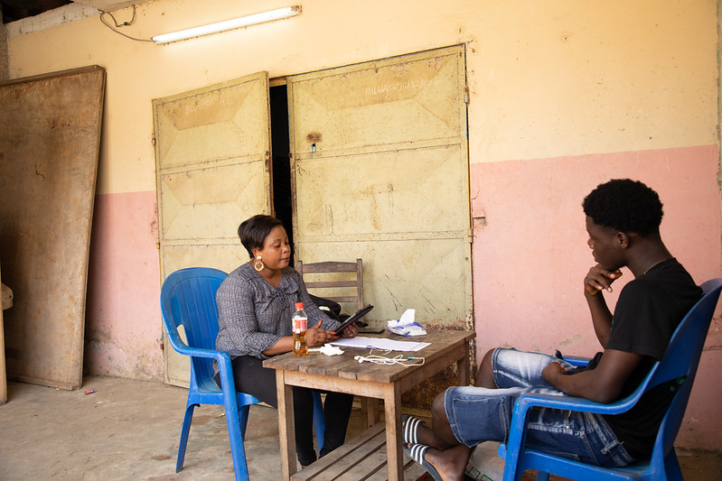
Democracy country scorecards
Notes:
Afrobarometer country democracy scorecards present graphic illustrations of our latest survey findings and over-time trends on key indicators of democratic demand and supply, from support for democratic norms and practices to satisfaction, freedoms, and perceptions of official corruption.

Slide 34
Conclusion
As with the rest of Africans, most West Africans continue to voice strong support for democratic governance;
But popular satisfaction with democracy, has witnessed a steady decline over the past decade;
Perceived supply of democracy continues to lag behind citizens’ aspirations (demand);
Need for governments to deliver democratic and accountable governance to match demand.

Slide 35
Thank you
www.afrobarometer.org
#VoicesAfrica on Twitter, Facebook, LinkedIn, Instagram.
Do your own data analysis – on any question, for any country and survey round.
It’s easy and free at www.afrobarometer.org/online-data-analysis.

